Slide 1
Design And Analysis of Algorithms OPTIMIZING MAKESPAN
By
Cheethirala Varun (2010030031)
K. Sai Anirudh (2010030083)
M.D. Fauzaan (2010030452)
B.Vegesh Sai (2010030024)

Slide 2
Abstract
There are n machines and m jobs. Each job contains exactly n operations. The i-th operation of the job must be executed on the i-th machine. No machine can perform more than one operation simultaneously. For each operation of each job, execution time is specified. Operations within one job must be performed in the specified order. The first operation gets executed on the first machine, then (as the first operation is finished) the second operation on the second machine, and so until the n-th operation. Jobs can be executed in any order, however. Problem definition implies that this job order is exactly the same for each machine. The problem is to determine the optimal such arrangement, i.e. the one with the shortest possible total job execution makespan.

Slide 3
Problem statement
Flow-shop scheduling may apply as well to production facilities as to computing designs. A special type of flow-shop scheduling problem is the permutation flow-shop scheduling problem in which the processing order of the jobs on the resources is the same for each subsequent step of processing.

Slide 4
ALGORITHM
Algorithm JOHNSON_FLOWSHOP(T, Q)
// T is array of time of jobs, each column indicating time on machine Mi
// Q is queue of jobs
Q = Φ
for j = 1 to n do
t = minimum machine time scanning in booth columns
if t occurs in column 1 then
Add Jobj to the first empty slot of Q
else
Add Jobj to last empty slot of Q
end
Remove processed job from consideration
end
return Q

Slide 5
FLOW CHART

Slide 6
start
Input job id’s no of machines, processing time
If more time
Remaining job id’s no. of machines, processing
Send to starting index of the priority queue
If less time
Send to last index of the priority queue
Order of job sequencing
stop

Slide 7
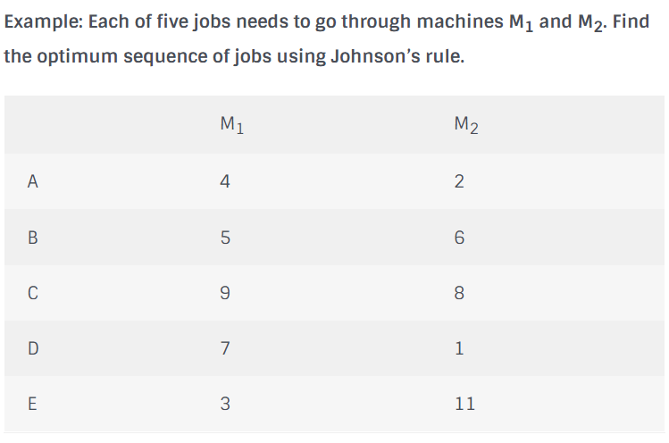
NUMERIC EXAMPLE OF THE ALGORITHM

Slide 8

Solution:
The smallest job is D, which is on machine M₁, so schedule this job last. And skip that job from further consideration.
Next smallest job is A, which is on machine M₂, so schedule the job in last possible empty slot. And skip that job from further consideration.
Next smallest job is E, which is on machine M₁, so schedule the job in earliest possible empty slot. And skip that job from further consideration.

Slide 9
Next smallest job is B, which is on machine M₁, so schedule the job in earliest possible empty slot. And skip that job from further consideration.
So final schedule is {E, B, C, A, D}.

Slide 10
Hardware and Software used
Colab

Slide 11
Division of work among the group members
BOPPANA VEGESH SAI – IMPLEMENTATION OF ALGORITHM
FAUZAAN – ALGORITHM DESIGN
CH.VARUN – GITHUB AND REQUIREMENTS GATHERING
ANIRUDH – REQUIREMENTS GATHERING AND DOCUMENT PREPARATIONS

Slide 12
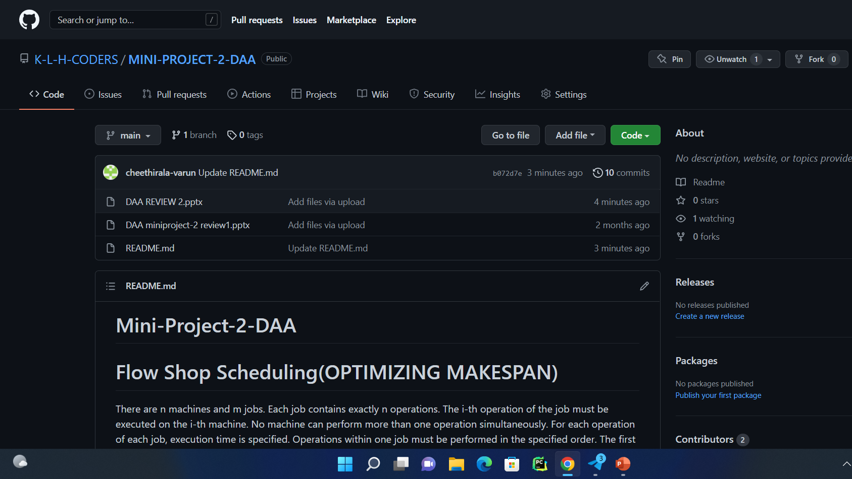
GitHub Commits

Slide 13
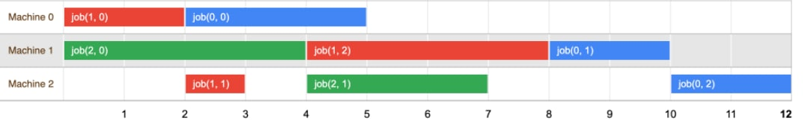
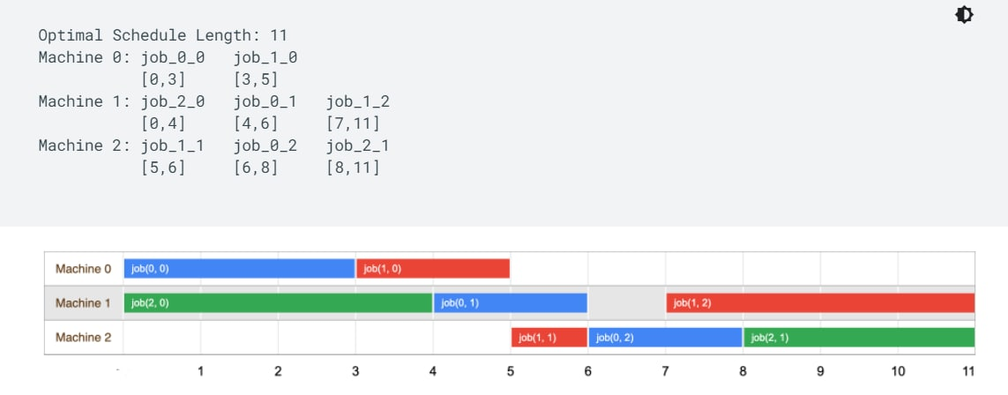
Result

